Slide 1
Pershing Hill Elementary School
Mitchell Reiners
AE Senior Thesis 2010
Construction Management

Slide 2
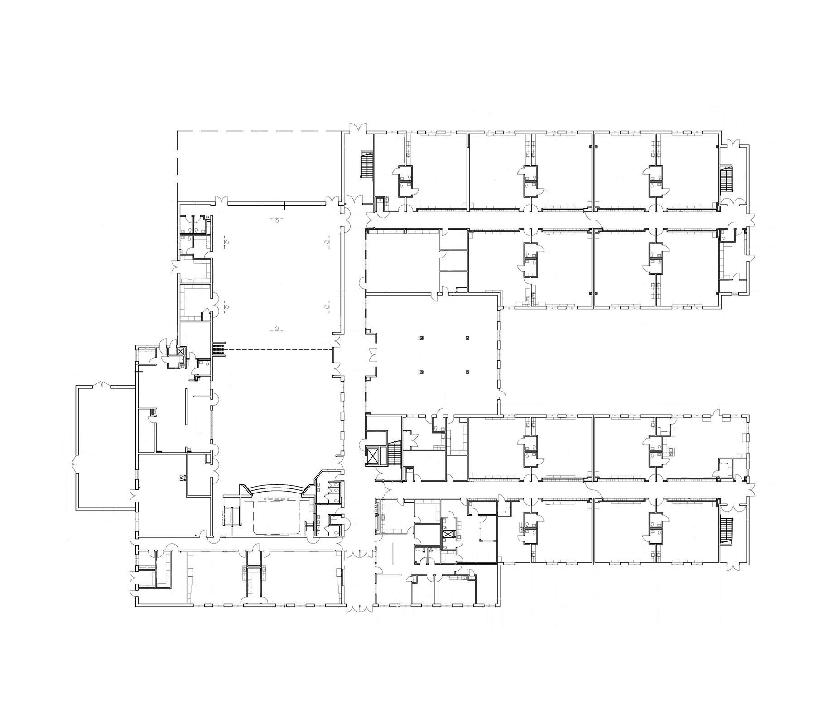
Presentation Outline
Pershing Hill Elementary School
Introduction
Analysis 1:
Green Roof
(Breath Topic)
Green Roof Properties
Structural Impact/Analysis
Constructability Analysis
Schedule Impact/Analysis
Analysis Conclusion
Analysis 2: Geothermal
(Breath Topic)
Geothermal System Properties
Schedule Impact/Analysis
Life Cycle Analysis
Analysis Conclusion
Analysis 3: Prefabrication
Prefabricated System Properties
Schedule Impact/Analysis
Constructability Analysis
Analysis Conclusion
Analysis 4: LEED Certification
Requirements Currently Met
Additional Requirements
Estimated Costs of Additional Requirements
Analysis Conclusion
Conclusion
Project Team and Building Information
Owner: Anne Arundel County Public Schools
Tenant: Pershing Hill Elementary School
Architect: Grimm and Parker Associates
Construction Manager: Jacobs
Construction Costs: $13.3 million
Total Costs to Owner: $15.1 million
Estimated Completion: Feb. 2011
Total size: 87,160 sqft
Delivery Method: Multiple prime
with 15 prime contractors
Project site lies entirely within a
US Army Base
Classroom Wing
Gymnasium
MediaCenter
Courtyard
Cafeteria
Main Entrance

Slide 3
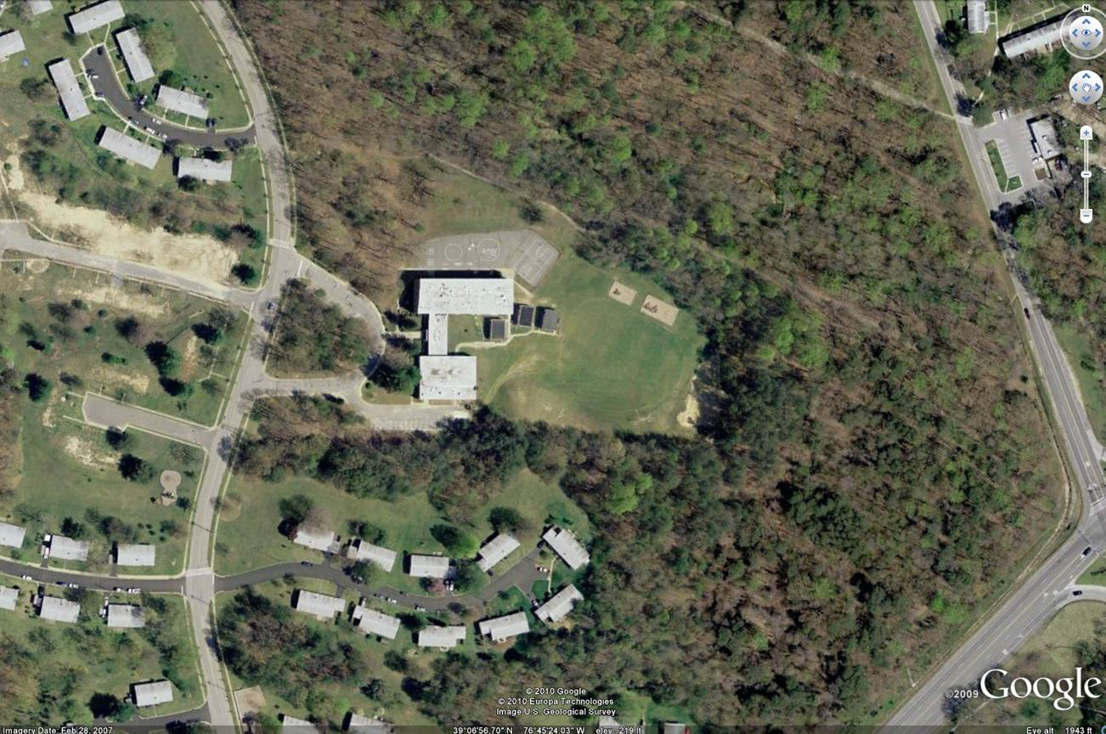
Presentation Outline
Pershing Hill Elementary School
Introduction
Analysis 1:
Green Roof
(Breath Topic)
Green Roof Properties
Structural Impact/Analysis
Constructability Analysis
Schedule Impact/Analysis
Analysis Conclusion
Analysis 2: Geothermal
(Breath Topic)
Geothermal System Properties
Schedule Impact/Analysis
Life Cycle Analysis
Analysis Conclusion
Analysis 3: Prefabrication
Prefabricated System Properties
Schedule Impact/Analysis
Constructability Analysis
Analysis Conclusion
Analysis 4: LEED Certification
Requirements Currently Met
Additional Requirements
Estimated Costs of Additional Requirements
Analysis Conclusion
Conclusion
First Occupied: 1960
Capacity of 297 Students
Demolition Started Sept 2, 2009
Classroom Wing
Gymnasium
MediaCenter
Courtyard
Cafeteria
Main Entrance

Slide 4
Presentation Outline
Pershing Hill Elementary School
Introduction
Analysis 1:
Green Roof
(Breath Topic)
Green Roof Properties
Structural Impact/Analysis
Constructability Analysis
Schedule Impact/Analysis
Analysis Conclusion
Analysis 2: Geothermal
(Breath Topic)
Geothermal System Properties
Schedule Impact/Analysis
Life Cycle Analysis
Analysis Conclusion
Analysis 3: Prefabrication
Prefabricated System Properties
Schedule Impact/Analysis
Constructability Analysis
Analysis Conclusion
Analysis 4: LEED Certification
Requirements Currently Met
Additional Requirements
Estimated Costs of Additional Requirements
Analysis Conclusion
Conclusion
Capacity of 733 Students
Portion of site in “critical wetlands area”
Classroom Wing
Gymnasium
MediaCenter
Courtyard
Cafeteria
Main Entrance

Slide 5
Presentation Outline
Analysis 1: Green Roof
Introduction
Analysis 1:
Green Roof
(Breath Topic)
Green Roof Properties
Structural Impact/Analysis
Constructability Analysis
Schedule Impact/Analysis
Analysis Conclusion
Analysis 2: Geothermal
(Breath Topic)
Geothermal System Properties
Schedule Impact/Analysis
Life Cycle Analysis
Analysis Conclusion
Analysis 3: Prefabrication
Prefabricated System Properties
Schedule Impact/Analysis
Constructability Analysis
Analysis Conclusion
Analysis 4: LEED Certification
Requirements Currently Met
Additional Requirements
Estimated Costs of Additional Requirements
Analysis Conclusion
Conclusion
Introduction to Analysis
Increase in impervious area → increased rainwater runoff
Classroom Wing
Gymnasium
MediaCenter
Courtyard
Cafeteria
Main Entrance
20,245 sqft building footprint
38,400 sqft paved area
42,595 sqft building footprint
104,700 sqft paved area

Slide 6
Presentation Outline
Analysis 1: Green Roof
Introduction
Analysis 1:
Green Roof
(Breath Topic)
Green Roof Properties
Structural Impact/Analysis
Constructability Analysis
Schedule Impact/Analysis
Analysis Conclusion
Analysis 2: Geothermal
(Breath Topic)
Geothermal System Properties
Schedule Impact/Analysis
Life Cycle Analysis
Analysis Conclusion
Analysis 3: Prefabrication
Prefabricated System Properties
Schedule Impact/Analysis
Constructability Analysis
Analysis Conclusion
Analysis 4: LEED Certification
Requirements Currently Met
Additional Requirements
Estimated Costs of Additional Requirements
Analysis Conclusion
Conclusion
Green Roof Properties
Rainwater runoff primarily dependent on depth of growing media
11.5” Growing media to equalize rain water runoff between old and new school
Classroom Wing
Gymnasium
MediaCenter
Courtyard
Cafeteria
Main Entrance

Slide 7
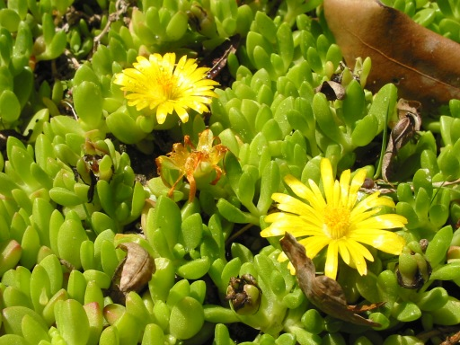
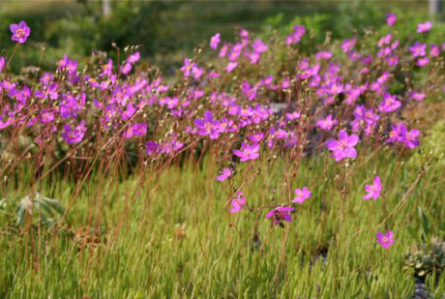
Presentation Outline
Analysis 1: Green Roof
Introduction
Analysis 1:
Green Roof
(Breath Topic)
Green Roof Properties
Structural Impact/Analysis
Constructability Analysis
Schedule Impact/Analysis
Analysis Conclusion
Analysis 2: Geothermal
(Breath Topic)
Geothermal System Properties
Schedule Impact/Analysis
Life Cycle Analysis
Analysis Conclusion
Analysis 3: Prefabrication
Prefabricated System Properties
Schedule Impact/Analysis
Constructability Analysis
Analysis Conclusion
Analysis 4: LEED Certification
Requirements Currently Met
Additional Requirements
Estimated Costs of Additional Requirements
Analysis Conclusion
Conclusion
Green Roof Properties
Talinum calycinum, Delosperma nubigenum, or similar due to soil depth and hardiness zone
Classroom Wing
Gymnasium
MediaCenter
Courtyard
Cafeteria
Main Entrance

Slide 8
Presentation Outline
Analysis 1: Green Roof
Introduction
Analysis 1:
Green Roof
(Breath Topic)
Green Roof Properties
Structural Impact/Analysis
Constructability Analysis
Schedule Impact/Analysis
Analysis Conclusion
Analysis 2: Geothermal
(Breath Topic)
Geothermal System Properties
Schedule Impact/Analysis
Life Cycle Analysis
Analysis Conclusion
Analysis 3: Prefabrication
Prefabricated System Properties
Schedule Impact/Analysis
Constructability Analysis
Analysis Conclusion
Analysis 4: LEED Certification
Requirements Currently Met
Additional Requirements
Estimated Costs of Additional Requirements
Analysis Conclusion
Conclusion
Structural Impact
Classroom Wing
Additional weight for typical bay:
101,545 pounds (120 pcf)
15,673 pounds (55 pcf drainage layer, 4 psf
filter fabric)
Gymnasium
MediaCenter
Courtyard
Cafeteria
Main Entrance

Slide 9
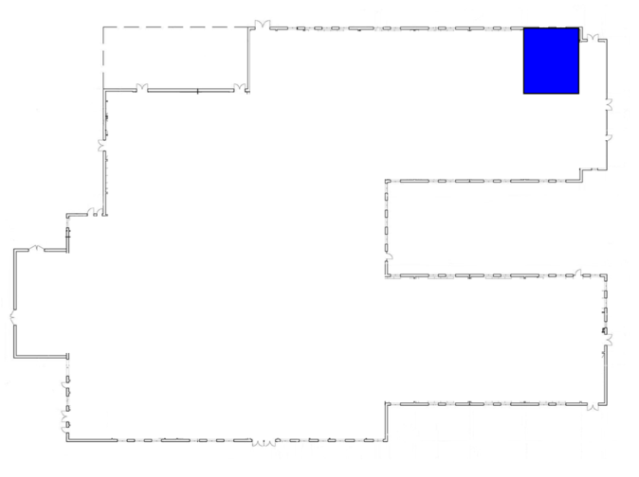
Presentation Outline
Analysis 1: Green Roof
Introduction
Analysis 1:
Green Roof
(Breath Topic)
Green Roof Properties
Structural Impact/Analysis
Constructability Analysis
Schedule Impact/Analysis
Analysis Conclusion
Analysis 2: Geothermal
(Breath Topic)
Geothermal System Properties
Schedule Impact/Analysis
Life Cycle Analysis
Analysis Conclusion
Analysis 3: Prefabrication
Prefabricated System Properties
Schedule Impact/Analysis
Constructability Analysis
Analysis Conclusion
Analysis 4: LEED Certification
Requirements Currently Met
Additional Requirements
Estimated Costs of Additional Requirements
Analysis Conclusion
Conclusion
Structural Impact
For Typical Bay:
Before:
20 gauge roof deck
18KCS2 joists at 5’ o.c.
W18 x 46 girders
HSS 9 x 5 x 3/8 exterior columns
HSS 9 x 5 x 1/2 interior columns
Classroom Wing
After:
19 gauge roof deck
18KCS2 joists at 3’ o.c.
W 18 x 143 girders
HSS 9 x 5 x 1/2 exterior columns
HSS 18 x 6 x 1/2 interior columns
Gymnasium
MediaCenter
Courtyard
Cafeteria
Main Entrance

Slide 10
Presentation Outline
Analysis 1: Green Roof
Introduction
Analysis 1:
Green Roof
(Breath Topic)
Green Roof Properties
Structural Impact/Analysis
Constructability Analysis
Schedule Impact/Analysis
Analysis Conclusion
Analysis 2: Geothermal
(Breath Topic)
Geothermal System Properties
Schedule Impact/Analysis
Life Cycle Analysis
Analysis Conclusion
Analysis 3: Prefabrication
Prefabricated System Properties
Schedule Impact/Analysis
Constructability Analysis
Analysis Conclusion
Analysis 4: LEED Certification
Requirements Currently Met
Additional Requirements
Estimated Costs of Additional Requirements
Analysis Conclusion
Conclusion
Constructability
Coordination with structural steel contractor
Coordination with mechanical contractor
Classroom Wing
Gymnasium
MediaCenter
Courtyard
Cafeteria
Main Entrance

Slide 11
Presentation Outline
Analysis 1: Green Roof
Introduction
Analysis 1:
Green Roof
(Breath Topic)
Green Roof Properties
Structural Impact/Analysis
Constructability Analysis
Schedule Impact/Analysis
Analysis Conclusion
Analysis 2: Geothermal
(Breath Topic)
Geothermal System Properties
Schedule Impact/Analysis
Life Cycle Analysis
Analysis Conclusion
Analysis 3: Prefabrication
Prefabricated System Properties
Schedule Impact/Analysis
Constructability Analysis
Analysis Conclusion
Analysis 4: LEED Certification
Requirements Currently Met
Additional Requirements
Estimated Costs of Additional Requirements
Analysis Conclusion
Conclusion
Schedule Impacts
No increase to final project completion date
9 additional work days to roofing contractor’s schedule
Classroom Wing
Gymnasium
MediaCenter
Courtyard
Cafeteria
Main Entrance

Slide 12
Presentation Outline
Analysis 1: Green Roof
Introduction
Analysis 1:
Green Roof
(Breath Topic)
Green Roof Properties
Structural Impact/Analysis
Constructability Analysis
Schedule Impact/Analysis
Analysis Conclusion
Analysis 2: Geothermal
(Breath Topic)
Geothermal System Properties
Schedule Impact/Analysis
Life Cycle Analysis
Analysis Conclusion
Analysis 3: Prefabrication
Prefabricated System Properties
Schedule Impact/Analysis
Constructability Analysis
Analysis Conclusion
Analysis 4: LEED Certification
Requirements Currently Met
Additional Requirements
Estimated Costs of Additional Requirements
Analysis Conclusion
Conclusion
Analysis Conclusion
Additional impervious area in the new building will contribute to an increase in rainwater runoff
Equalizing the amount of runoff from the new building and existing structures would require a green roof with 11.5 inches of growing media
An intensive green roof would require the existing structural members be resized
A green roof would result in an increased need for coordination between contractors
A green roof would result in an increased schedule duration for the roofing contractor.
Classroom Wing
Gymnasium
MediaCenter
Courtyard
Cafeteria
Main Entrance

Slide 13
Presentation Outline
Analysis 2: Geothermal
Introduction
Analysis 1:
Green Roof
(Breath Topic)
Green Roof Properties
Structural Impact/Analysis
Constructability Analysis
Schedule Impact/Analysis
Analysis Conclusion
Analysis 2: Geothermal
(Breath Topic)
Geothermal System Properties
Schedule Impact/Analysis
Life Cycle Analysis
Analysis Conclusion
Analysis 3: Prefabrication
Prefabricated System Properties
Schedule Impact/Analysis
Constructability Analysis
Analysis Conclusion
Analysis 4: LEED Certification
Requirements Currently Met
Additional Requirements
Estimated Costs of Additional Requirements
Analysis Conclusion
Conclusion
Introduction to Analysis
More geothermal systems being implemented in schools
Government incentives for alternative energy sources
LEED points
Significant upfront costs
Classroom Wing
Gymnasium
MediaCenter
Courtyard
Cafeteria
Main Entrance

Slide 14
Presentation Outline
Analysis 2: Geothermal
Introduction
Analysis 1:
Green Roof
(Breath Topic)
Green Roof Properties
Structural Impact/Analysis
Constructability Analysis
Schedule Impact/Analysis
Analysis Conclusion
Analysis 2: Geothermal
(Breath Topic)
Geothermal System Properties
Schedule Impact/Analysis
Life Cycle Analysis
Analysis Conclusion
Analysis 3: Prefabrication
Prefabricated System Properties
Schedule Impact/Analysis
Constructability Analysis
Analysis Conclusion
Analysis 4: LEED Certification
Requirements Currently Met
Additional Requirements
Estimated Costs of Additional Requirements
Analysis Conclusion
Conclusion
System Properties
Classroom Wing
Adequacy of water and water temperature not tested for site; water quality can change over time
↓
Direct expansion system (closed loop)
Monovalent System
Gymnasium
MediaCenter
Courtyard
Cafeteria
Main Entrance

Slide 15
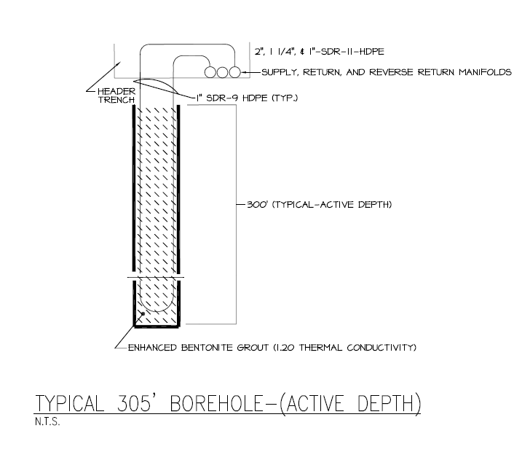
Presentation Outline
Analysis 2: Geothermal
Introduction
Analysis 1:
Green Roof
(Breath Topic)
Green Roof Properties
Structural Impact/Analysis
Constructability Analysis
Schedule Impact/Analysis
Analysis Conclusion
Analysis 2: Geothermal
(Breath Topic)
Geothermal System Properties
Schedule Impact/Analysis
Life Cycle Analysis
Analysis Conclusion
Analysis 3: Prefabrication
Prefabricated System Properties
Schedule Impact/Analysis
Constructability Analysis
Analysis Conclusion
Analysis 4: LEED Certification
Requirements Currently Met
Additional Requirements
Estimated Costs of Additional Requirements
Analysis Conclusion
Conclusion
System Properties
237,481 BTU/Hr needed to heat the building during the winter
Classroom Wing
Gymnasium
MediaCenter
Courtyard
Cafeteria
X 27
Main Entrance
Image courtesy of Foreman University

Slide 16
Presentation Outline
Analysis 2: Geothermal
Introduction
Analysis 1:
Green Roof
(Breath Topic)
Green Roof Properties
Structural Impact/Analysis
Constructability Analysis
Schedule Impact/Analysis
Analysis Conclusion
Analysis 2: Geothermal
(Breath Topic)
Geothermal System Properties
Schedule Impact/Analysis
Life Cycle Analysis
Analysis Conclusion
Analysis 3: Prefabrication
Prefabricated System Properties
Schedule Impact/Analysis
Constructability Analysis
Analysis Conclusion
Analysis 4: LEED Certification
Requirements Currently Met
Additional Requirements
Estimated Costs of Additional Requirements
Analysis Conclusion
Conclusion
Schedule Impact
Increased Time:
Installing Equipment
Additional Excavation
Offset by:
Additional Crews
Overlapping excavation and instillation
Acceleration of drywall instillation (critical path activity later in construction)
Classroom Wing
Gymnasium
MediaCenter
Courtyard
Cafeteria
Main Entrance

Slide 17
Presentation Outline
Analysis 2: Geothermal
Introduction
Analysis 1:
Green Roof
(Breath Topic)
Green Roof Properties
Structural Impact/Analysis
Constructability Analysis
Schedule Impact/Analysis
Analysis Conclusion
Analysis 2: Geothermal
(Breath Topic)
Geothermal System Properties
Schedule Impact/Analysis
Life Cycle Analysis
Analysis Conclusion
Analysis 3: Prefabrication
Prefabricated System Properties
Schedule Impact/Analysis
Constructability Analysis
Analysis Conclusion
Analysis 4: LEED Certification
Requirements Currently Met
Additional Requirements
Estimated Costs of Additional Requirements
Analysis Conclusion
Conclusion
Schedule Impact / Life Cycle Analysis
Additional Construction Time → Additional General Conditions
Classroom Wing
Gymnasium
 |  | Cost | Quantity | Unit | Total
Staffing | Project Manager | 2975 | 2 | week | $5,950
 | Superintendent | 2750 | 2 | week | $5,500
 | Assistant Super. | 2475 | 2 | week | $4,950
 | Project Engineer | 1800 | 2 | week | $3,600
 | Clerk | 590 | 2 | week | $1,180
CM Fee |  | 4.6 |  | % of Project | $31,683
Temporary Utilities | Trailer Rental | 310 | 0.5 | month | $155
Field Office Expenses | Office Equipment | 171 | 0.5 | month | $86
 | Office Supplies | 94 | 0.5 | month | $47
 | Telephone bill | 88 | 0.5 | month | $44
 | Lights and HVAC | 165 | 0.5 | month | $83
Estimated Cost | $53,277 | Location Factor | 0.93 | Total Cost | $49,548
MediaCenter
Courtyard
Cafeteria
Main Entrance

Slide 18
Presentation Outline
Analysis 2: Geothermal
Introduction
Analysis 1:
Green Roof
(Breath Topic)
Green Roof Properties
Structural Impact/Analysis
Constructability Analysis
Schedule Impact/Analysis
Analysis Conclusion
Analysis 2: Geothermal
(Breath Topic)
Geothermal System Properties
Schedule Impact/Analysis
Life Cycle Analysis
Analysis Conclusion
Analysis 3: Prefabrication
Prefabricated System Properties
Schedule Impact/Analysis
Constructability Analysis
Analysis Conclusion
Analysis 4: LEED Certification
Requirements Currently Met
Additional Requirements
Estimated Costs of Additional Requirements
Analysis Conclusion
Conclusion
Life Cycle Analysis
Upfront Costs:
Additional General Conditions
Additional Excavation
Additional Costs of system components
Total upfront cost $736,023
MD tax Incentives approx. $10,000
Lifecycle Savings:
Energy saved by geothermal system
-
Energy used by geothermal system
Classroom Wing
Gymnasium
MediaCenter
Courtyard
Cafeteria
Main Entrance

Slide 19
Presentation Outline
Analysis 2: Geothermal
Introduction
Analysis 1:
Green Roof
(Breath Topic)
Green Roof Properties
Structural Impact/Analysis
Constructability Analysis
Schedule Impact/Analysis
Analysis Conclusion
Analysis 2: Geothermal
(Breath Topic)
Geothermal System Properties
Schedule Impact/Analysis
Life Cycle Analysis
Analysis Conclusion
Analysis 3: Prefabrication
Prefabricated System Properties
Schedule Impact/Analysis
Constructability Analysis
Analysis Conclusion
Analysis 4: LEED Certification
Requirements Currently Met
Additional Requirements
Estimated Costs of Additional Requirements
Analysis Conclusion
Conclusion
Life Cycle Analysis
Classroom Wing
Gymnasium
MediaCenter
Courtyard
Cafeteria
Main Entrance
Internal Rate of Return = 1.68% (1.71% w/ tax incentives)
With 3% inflation rate PV= -271,412.27

Slide 20
Presentation Outline
Analysis 2: Geothermal
Introduction
Analysis 1:
Green Roof
(Breath Topic)
Green Roof Properties
Structural Impact/Analysis
Constructability Analysis
Schedule Impact/Analysis
Analysis Conclusion
Analysis 2: Geothermal
(Breath Topic)
Geothermal System Properties
Schedule Impact/Analysis
Life Cycle Analysis
Analysis Conclusion
Analysis 3: Prefabrication
Prefabricated System Properties
Schedule Impact/Analysis
Constructability Analysis
Analysis Conclusion
Analysis 4: LEED Certification
Requirements Currently Met
Additional Requirements
Estimated Costs of Additional Requirements
Analysis Conclusion
Conclusion
Analysis Conclusion
Geothermal system will add between 10 and 31 workdays to project schedule
Schedule impacts will result in additional general conditions
Internal rate of return less than 2%
Classroom Wing
Gymnasium
MediaCenter
Courtyard
Cafeteria
Main Entrance

Slide 21
Presentation Outline
Analysis 3: Prefabrication
Introduction
Analysis 1:
Green Roof
(Breath Topic)
Green Roof Properties
Structural Impact/Analysis
Constructability Analysis
Schedule Impact/Analysis
Analysis Conclusion
Analysis 2: Geothermal
(Breath Topic)
Geothermal System Properties
Schedule Impact/Analysis
Life Cycle Analysis
Analysis Conclusion
Analysis 3: Prefabrication
Prefabricated System Properties
Schedule Impact/Analysis
Constructability Analysis
Analysis Conclusion
Analysis 4: LEED Certification
Requirements Currently Met
Additional Requirements
Estimated Costs of Additional Requirements
Analysis Conclusion
Conclusion
Introduction to Analysis
Higher Quality
Reduced on-site construction time
Eliminates need for cold-weather construction practices
Eliminates need for scaffolding
Requires crane
Classroom Wing
Gymnasium
MediaCenter
Courtyard
Cafeteria
Main Entrance

Slide 22
Presentation Outline
Analysis 3: Prefabrication
Introduction
Analysis 1:
Green Roof
(Breath Topic)
Green Roof Properties
Structural Impact/Analysis
Constructability Analysis
Schedule Impact/Analysis
Analysis Conclusion
Analysis 2: Geothermal
(Breath Topic)
Geothermal System Properties
Schedule Impact/Analysis
Life Cycle Analysis
Analysis Conclusion
Analysis 3: Prefabrication
Prefabricated System Properties
Schedule Impact/Analysis
Constructability Analysis
Analysis Conclusion
Analysis 4: LEED Certification
Requirements Currently Met
Additional Requirements
Estimated Costs of Additional Requirements
Analysis Conclusion
Conclusion
System Properties
Panels constructed using hand-laying method
↓
Masonry contractor’s regular workforce can serve
as off-site prefabricator
Casting method not appropriate for this project
Classroom Wing
Gymnasium
MediaCenter
Courtyard
Cafeteria
Main Entrance

Slide 23
Presentation Outline
Analysis 3: Prefabrication
Introduction
Analysis 1:
Green Roof
(Breath Topic)
Green Roof Properties
Structural Impact/Analysis
Constructability Analysis
Schedule Impact/Analysis
Analysis Conclusion
Analysis 2: Geothermal
(Breath Topic)
Geothermal System Properties
Schedule Impact/Analysis
Life Cycle Analysis
Analysis Conclusion
Analysis 3: Prefabrication
Prefabricated System Properties
Schedule Impact/Analysis
Constructability Analysis
Analysis Conclusion
Analysis 4: LEED Certification
Requirements Currently Met
Additional Requirements
Estimated Costs of Additional Requirements
Analysis Conclusion
Conclusion
Schedule Impacts
Increased daily output from 240 sqft/day to 500 sqft/day
↓
Moves end date for masonry activities from July 21 to July 2
Reduces schedule for entire project by 2 days
Classroom Wing
Gymnasium
MediaCenter
Courtyard
Cafeteria
Main Entrance

Slide 24
Presentation Outline
Analysis 3: Prefabrication
Introduction
Analysis 1:
Green Roof
(Breath Topic)
Green Roof Properties
Structural Impact/Analysis
Constructability Analysis
Schedule Impact/Analysis
Analysis Conclusion
Analysis 2: Geothermal
(Breath Topic)
Geothermal System Properties
Schedule Impact/Analysis
Life Cycle Analysis
Analysis Conclusion
Analysis 3: Prefabrication
Prefabricated System Properties
Schedule Impact/Analysis
Constructability Analysis
Analysis Conclusion
Analysis 4: LEED Certification
Requirements Currently Met
Additional Requirements
Estimated Costs of Additional Requirements
Analysis Conclusion
Conclusion
Constructability Analysis
Need for crane → ◦Coordination with steel erection
◦Additional crane needed for three months (alignment between trade schedules)
Masonry done over winter → ◦Elimination of cold weather construction techniques
Storage of Panels → ◦Timed delivery of panels
Classroom Wing
Gymnasium
Area C
MediaCenter
Courtyard
Area A
Cafeteria
Area B
Main Entrance

Slide 25
Presentation Outline
Analysis 3: Prefabrication
Introduction
Analysis 1:
Green Roof
(Breath Topic)
Green Roof Properties
Structural Impact/Analysis
Constructability Analysis
Schedule Impact/Analysis
Analysis Conclusion
Analysis 2: Geothermal
(Breath Topic)
Geothermal System Properties
Schedule Impact/Analysis
Life Cycle Analysis
Analysis Conclusion
Analysis 3: Prefabrication
Prefabricated System Properties
Schedule Impact/Analysis
Constructability Analysis
Analysis Conclusion
Analysis 4: LEED Certification
Requirements Currently Met
Additional Requirements
Estimated Costs of Additional Requirements
Analysis Conclusion
Conclusion
Analysis Conclusion
Schedule benefits
Additional crane required for three months total during construction
Increased coordination between masonry and structural steel
Eliminate need for cold weather construction techniques
Classroom Wing
Gymnasium
MediaCenter
Courtyard
Cafeteria
Main Entrance

Slide 26
Presentation Outline
Analysis 4: LEED Certification
Introduction
Analysis 1:
Green Roof
(Breath Topic)
Green Roof Properties
Structural Impact/Analysis
Constructability Analysis
Schedule Impact/Analysis
Analysis Conclusion
Analysis 2: Geothermal
(Breath Topic)
Geothermal System Properties
Schedule Impact/Analysis
Life Cycle Analysis
Analysis Conclusion
Analysis 3: Prefabrication
Prefabricated System Properties
Schedule Impact/Analysis
Constructability Analysis
Analysis Conclusion
Analysis 4: LEED Certification
Requirements Currently Met
Additional Requirements
Estimated Costs of Additional Requirements
Analysis Conclusion
Conclusion
Introduction to Analysis
More schools moving towards LEED certification
Little or no additional upfront cost
Averaged premium of 1.7% when compared to non-LEED schools (Greg Kats 2006)
Classroom Wing
Gymnasium
MediaCenter
Courtyard
Cafeteria
Main Entrance

Slide 27
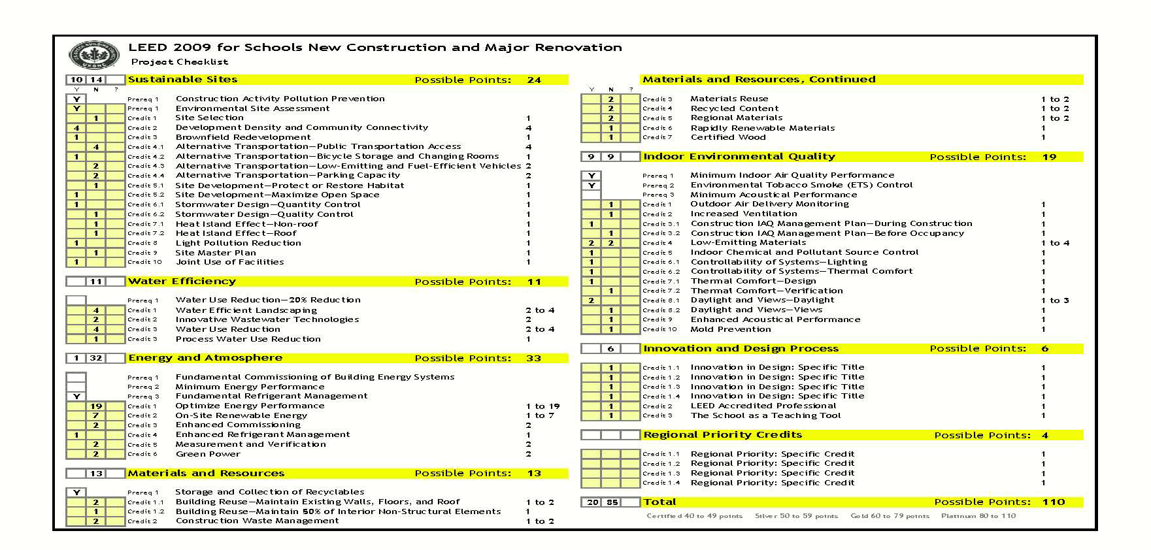
Presentation Outline
Analysis 4: LEED Certification
Introduction
Analysis 1:
Green Roof
(Breath Topic)
Green Roof Properties
Structural Impact/Analysis
Constructability Analysis
Schedule Impact/Analysis
Analysis Conclusion
Analysis 2: Geothermal
(Breath Topic)
Geothermal System Properties
Schedule Impact/Analysis
Life Cycle Analysis
Analysis Conclusion
Analysis 3: Prefabrication
Prefabricated System Properties
Schedule Impact/Analysis
Constructability Analysis
Analysis Conclusion
Analysis 4: LEED Certification
Requirements Currently Met
Additional Requirements
Estimated Costs of Additional Requirements
Analysis Conclusion
Conclusion
Requirements Currently Met
6 of 10 prerequisites
20 points (40 required)
Classroom Wing
Gymnasium
MediaCenter
Courtyard
Cafeteria
Main Entrance

Slide 28
Presentation Outline
Analysis 4: LEED Certification
Introduction
Analysis 1:
Green Roof
(Breath Topic)
Green Roof Properties
Structural Impact/Analysis
Constructability Analysis
Schedule Impact/Analysis
Analysis Conclusion
Analysis 2: Geothermal
(Breath Topic)
Geothermal System Properties
Schedule Impact/Analysis
Life Cycle Analysis
Analysis Conclusion
Analysis 3: Prefabrication
Prefabricated System Properties
Schedule Impact/Analysis
Constructability Analysis
Analysis Conclusion
Analysis 4: LEED Certification
Requirements Currently Met
Additional Requirements
Estimated Costs of Additional Requirements
Analysis Conclusion
Conclusion
Additional Requirements
Water Efficiency Prerequisite 1: Water Use Reduction
Energy and Atmosphere Prerequisite 1: Fundamental Commissioning of Building Energy Systems
Energy and Atmosphere Prerequisite 2: Minimum Energy Performance
Indoor Environmental Quality Prerequisite 3: Minimum Acoustical Performance
20 additional points from other activities
Classroom Wing
Gymnasium
MediaCenter
Courtyard
Cafeteria
Main Entrance

Slide 29
Presentation Outline
Analysis 4: LEED Certification
Introduction
Analysis 1:
Green Roof
(Breath Topic)
Green Roof Properties
Structural Impact/Analysis
Constructability Analysis
Schedule Impact/Analysis
Analysis Conclusion
Analysis 2: Geothermal
(Breath Topic)
Geothermal System Properties
Schedule Impact/Analysis
Life Cycle Analysis
Analysis Conclusion
Analysis 3: Prefabrication
Prefabricated System Properties
Schedule Impact/Analysis
Constructability Analysis
Analysis Conclusion
Analysis 4: LEED Certification
Requirements Currently Met
Additional Requirements
Estimated Costs of Additional Requirements
Analysis Conclusion
Conclusion
Costs of Additional Requirements
Classroom Wing
Gymnasium
MediaCenter
Courtyard
Cafeteria
Main Entrance

Slide 30
Presentation Outline
Analysis 4: LEED Certification
Introduction
Analysis 1:
Green Roof
(Breath Topic)
Green Roof Properties
Structural Impact/Analysis
Constructability Analysis
Schedule Impact/Analysis
Analysis Conclusion
Analysis 2: Geothermal
(Breath Topic)
Geothermal System Properties
Schedule Impact/Analysis
Life Cycle Analysis
Analysis Conclusion
Analysis 3: Prefabrication
Prefabricated System Properties
Schedule Impact/Analysis
Constructability Analysis
Analysis Conclusion
Analysis 4: LEED Certification
Requirements Currently Met
Additional Requirements
Estimated Costs of Additional Requirements
Analysis Conclusion
Conclusion
Costs of Additional Requirements
Savings can be perused even if LEED certification is not
Additional initial costs between $891,417 and $924,697 to peruse LEED certification (around 6.8% of project cost)
Classroom Wing
Gymnasium
MediaCenter
Courtyard
Cafeteria
Main Entrance

Slide 31
Presentation Outline
Analysis 4: LEED Certification
Introduction
Analysis 1:
Green Roof
(Breath Topic)
Green Roof Properties
Structural Impact/Analysis
Constructability Analysis
Schedule Impact/Analysis
Analysis Conclusion
Analysis 2: Geothermal
(Breath Topic)
Geothermal System Properties
Schedule Impact/Analysis
Life Cycle Analysis
Analysis Conclusion
Analysis 3: Prefabrication
Prefabricated System Properties
Schedule Impact/Analysis
Constructability Analysis
Analysis Conclusion
Analysis 4: LEED Certification
Requirements Currently Met
Additional Requirements
Estimated Costs of Additional Requirements
Analysis Conclusion
Conclusion
Analysis Conclusion
Large initial costs associated with perusing LEED certification (around 6.8% of total project cost)
Several value engineering ideas more likely to be perused if LEED certification is
↓
Partially offset the additional costs associated with LEED certification
Classroom Wing
Gymnasium
MediaCenter
Courtyard
Cafeteria
Main Entrance

Slide 32
Presentation Outline
Acknowledgments
Introduction
Analysis 1:
Green Roof
(Breath Topic)
Green Roof Properties
Structural Impact/Analysis
Constructability Analysis
Schedule Impact/Analysis
Analysis Conclusion
Analysis 2: Geothermal
(Breath Topic)
Geothermal System Properties
Schedule Impact/Analysis
Life Cycle Analysis
Analysis Conclusion
Analysis 3: Prefabrication
Prefabricated System Properties
Schedule Impact/Analysis
Constructability Analysis
Analysis Conclusion
Analysis 4: LEED Certification
Requirements Currently Met
Additional Requirements
Estimated Costs of Additional Requirements
Analysis Conclusion
Conclusion
I would like to thank the following people for their help in achieving my senior thesis objectives this semester:
The Faculty and Staff of the Penn State Architectural Engineering Department, and Dr. Magent for his advice and guidance throughout the year
Anne Arundel County, for allowing me to study Pershing Hill Elementary School
The Pershing Hill Elementary School Project Team including Ani Nigudkar, Andrew Locke, and Dennis Scholle for taking time to talk with me and for providing me with information about Pershing Hill Elementary School.
Michael Arnold and Foreman University for the informative presentation on geothermal systems
Heather Summerlin and Jonathan Richmond for their help with my CPEP website
Classroom Wing
Gymnasium
MediaCenter
Courtyard
Cafeteria
Main Entrance

Slide 33
Question and Answer

